Slide 1

WIPRO NGA Program – LSP Batch
Capstone Project Presentation – 12 August 2024
Project Title Here - Online Movie Ticket Booking (Using Client Server Application)
Presented by – Manimala Kancharla
www. rpsconsulting. in

Slide 2
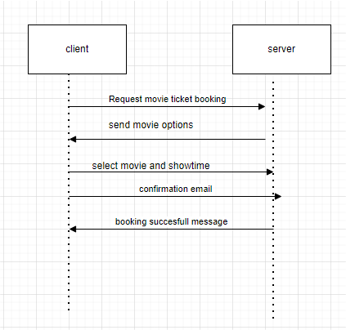

Process Flow:

Slide 3
PROJECT OVERVIEW
This project involves the development of a simple client-server application in C that simulates a movie ticket booking system. The server maintains a list of available movie shows, each with a time, title, and price. The client connects to the server, receives the list of available shows, selects a show to book, and then receives confirmation of the booking from the server.
INTRODUCTION
The project demonstrates a basic implementation of TCP/IP socket programming in C, focusing on creating a simple and interactive movie ticket booking system. This system consists of a server that provides movie show information and handles booking requests from clients, and a client application that allows users to interact with the server to view and book movie tickets.

Slide 4
MOTIVATION The motivation behind this project is to gain hands-on experience with network programming using TCP sockets, as well as to understand the dynamics of client-server architecture. It also serves as a practical example of how to manage simple communication protocols between a client and a server over a network. Project Scope *Client-Server Communication*: Establish a TCP connection between a client and server. - *Data Transmission*: The server sends a list of movie shows to the client, and the client sends booking requests back to the server. - *Booking Confirmation*: The server processes the client's booking request and sends back a confirmation or error message. -

Slide 5
*Basic Error Handling*: Handle common errors such as invalid inputs and connection issues.

Slide 6
Various Tools Used in This Project
Programming Language: C
Compiler: GCC (GNU Compiler Collection)
Debugger: GDB (GNU Debugger)
Socket Programming: UNIX Socket API (e.g., socket(), bind(), listen(), accept(), connect())
Operating System: Linux/Unix or any system that supports POSIX API
Text Editor/IDE: Any text editor or IDE (e.g., VSCode, Vim, Emacs)
List of Functions Used in This Project
1.Server Functions
2. Client Functions
Server Functions:
socket(): Creates a new socket.
setsockopt(): Sets options on the socket.
bind(): Binds the socket to a specific IP address and port.
listen(): Prepares the server to accept incoming connections.
accept(): Accepts a new connection from a client.
send(): Sends data to the client.
read(): Receives data from the client.
close(): Closes the socket.

Slide 7
Client Functions:
socket(): Creates a new socket.
connect(): Connects the client to the server.
send(): Sends data to the server.
read(): Receives data from the server.
close(): Closes the socket.
File Operations Functions:
In this specific implementation, there are no file operations functions, as all communication happens over the network between the client and server using sockets. However, if you were to extend this project to include file operations (e.g., logging bookings, reading from a file to get show details), functions like fopen(), fread(), fwrite(), and fclose() would be relevant.

Slide 8
Build and Compilation Tools:
GCC: The GNU Compiler Collection is used to compile the C code. The command gcc server.c -o server compiles the server code, and gcc client.c -o client compiles the client code.
Makefile (optional): You can create a Makefile to automate the build process, allowing you to compile both the client and server with a single command (make).

Slide 9
Future Amendments and Addressing Common Challenges Future Enhancements: Concurrency: Implement multi-threading or multi-processing on the server to handle multiple clients simultaneously. Data Persistence: Integrate file operations or a database to persistently store movie shows and bookings. Enhanced Security: Implement security measures like SSL/TLS for encrypted communication, and validate inputs more rigorously to prevent attacks. Advanced User Interface: Develop a more sophisticated client-side UI using a GUI framework or a web-based interface.

Slide 10
Challenges Addressed Handling Multiple Clients: The current design is single-threaded; future versions can use threading to manage multiple clients. Network Issues: Address network latency, dropped connections, and ensure data integrity with retries and checksums. Input Validation: Ensure robust validation of client inputs to prevent errors or potential security vulnerabilities.

Slide 11
Timer Functions:-
1. Limiting the Time for Client Response: If a client doesn't respond within a specific time, the server could automatically close the connection.
2. Delaying Responses: To simulate processing time on the server or to create a delay before sending a response.
3. Measuring Execution Time: Measure how long it takes to process a client's request.
1. Limiting Client Response Time on the Server
You can use setitimer() in combination with signal() to limit the time the server waits for a client's response. If the client does not respond within the set time, the server can close the connection.

Slide 12
2. Measuring Execution Time To measure how long certain parts of the server code take to execute (e.g., processing a client’s request), you can use clock() from time.h. 3. Implementing a Delay You might want to delay the server's response to simulate processing time or to give a more realistic interaction. 4. Handling Long-Running Tasks with Timers For more complex scenarios, such as scheduling a task after a certain period, you could use setitimer() to periodically check or perform certain actions in your server.

Slide 13
Conclusion
This project serves as an introductory exploration into network programming and the basics of client-server architecture using TCP sockets in C. By completing this project, we gain an understanding of how to establish and manage network connections, transmit data between a server and clients, and process client requests in a structured manner. The project can be further expanded to include more complex features such as concurrency, data persistence, and enhanced security, making it a solid foundation for more advanced networking projects.

Slide 14
Thank You
2024- Rps Consulting all rights reserved

